Slide 1
ENGINEERING GRAPHICS
Topic:
Dimensioning

Slide 2
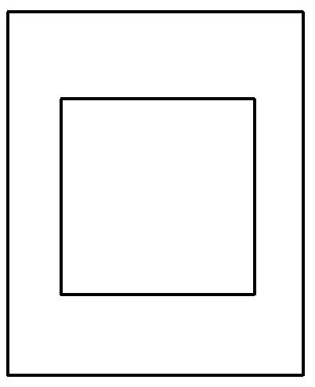
Dimensioning
Dimensioning refers to the act of giving dimensions.
45
45
80
60

Slide 3



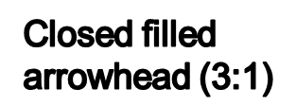




Elements of Dimensioning
80
Front View

Slide 4
Closed filled arrowhead
1
3

Slide 5
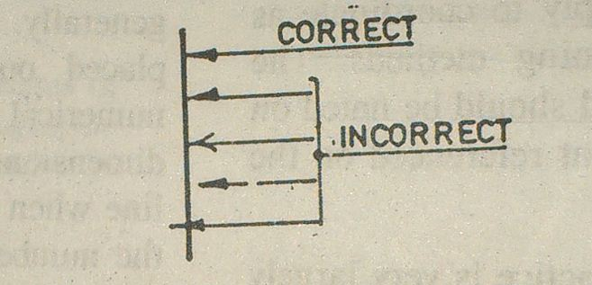
Closed filled arrowhead
Good & Bad Practices

Slide 6
Leader
Ø30

Slide 7
Systems of Dimensioning
There are two systems of dimensioning:
a) Aligned System
b) Uni-directional System

Slide 8
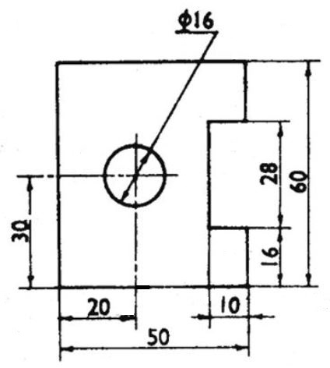
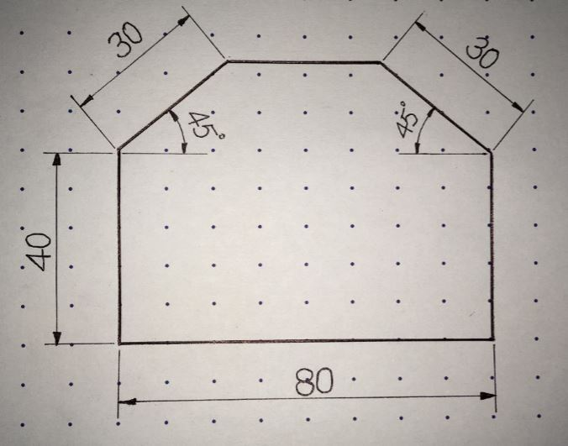
Systems of Dimensioning
Aligned System
In the aligned system, dimensions are placed perpendicular to the dimension line so that they may be read from the bottom or right-hand side of the drawing sheet. Dimensions are placed at the middle and on top of the dimension lines.

Slide 9
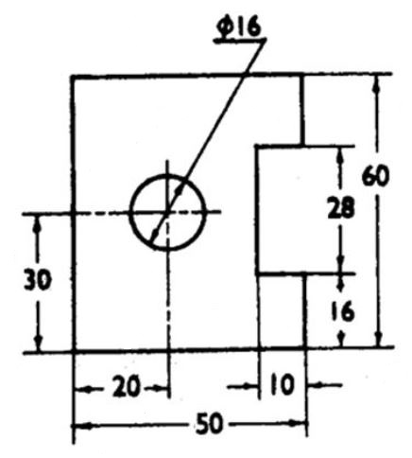
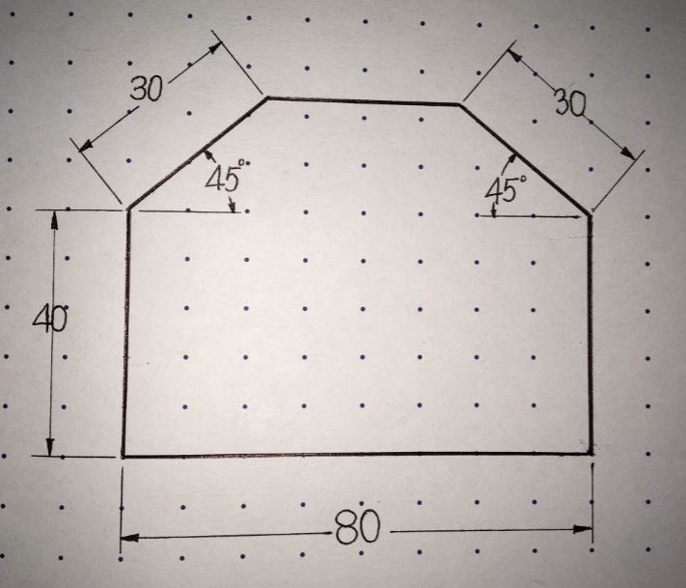
Systems of Dimensioning
Unidirectional System
In the unidirectional system, dimensions are placed in such a way that they can be read from the bottom edge of the drawing sheet. All dimensions are placed at the middle and are inserted by breaking the dimension lines at the middle.

Slide 10
Rule of Dimensioning
Between any two extension lines, there must be one and only one dimension line bearing one dimension.
As far as possible, all the dimensions should be placed outside the views. Inside dimensions are preferred only if they are clearer and more easily readable.
All the dimensions on a drawing must be shown using either Aligned System or Unidirectional System. In no case should, the two systems be mixed on the same drawing.
The same unit of length should be used for all the dimensions on a drawing. The unit should not be written after each dimension, but a note mentioning the unit should be placed below the drawing.
Dimension lines should not cross each other. Dimension lines should also not cross any other lines of the object.
All dimensions must be given.
Each dimension should be given only once. No dimension should be redundant.
.

Slide 11
Methods of Dimensioning
For dimensions in series, there are three methods:
Chain Dimensioning
Parallel Dimensioning
Combined Dimensioning
Adopt any one of these methods.
  Chain dimensioning (Continuous dimensioning): All the dimensions are aligned in such a way that an arrowhead of one dimension touches tip-to-tip the arrowhead of the adjacent dimension. The overall dimension is placed outside the other smaller dimensions.

Slide 12
Methods of Dimensioning
CHAIN DIMENSIONING
10
10
10

Slide 13
Methods of Dimensioning
  Parallel dimensioning (Progressive dimensioning):
  All the dimensions are shown from a common reference line. Obviously, all these dimensions share a common extension line. This method is adopted when dimensions have to be established from a particular datum surface.

Slide 14
Methods of Dimensioning
PARALLEL DIMENSIONING
10
20
30

Slide 15
Methods of Dimensioning
  Combined dimensioning:
  When both the methods, i.e., chain dimensioning and parallel dimensioning are used on the same drawing, the method of dimensioning is called combined dimensioning.

Slide 16
Methods of Dimensioning
COMBINED DIMENSIONING
10
10
30

Slide 17
Dimensioning of Circular Features
Ø 12
Ø 30
Ø 30
Ø 20

Slide 18
Dimensioning of Circular Features
R10
R20
R5
R5

Slide 19
Thanks

